Slide 1
COVID Tracking Project
Group 9
Erica Liu, Veronica Lin
Yujun Sun, Shan Zhong

Slide 2

Table of Contents
Project Architecture Overview
Data Issues & Cleaning Strategy
Analytical Findings
Repository & Shiny App Walkthrough

Slide 3


Project
Architecture
Data source & API choice
  COVID Tracking Project API
(US + state daily COVID metrics)
  Public, well-documented, consistent JSON/CSV schema

Slide 4
Project Architecture
Design goals
  Reproducible, automated pipeline
High-level Architecture
  API -> data/raw/
  Airflow DAG runs Python ETL
  Clean tables stored in SQLite
  Notebooks & Shiny app read from the processed database

Slide 5
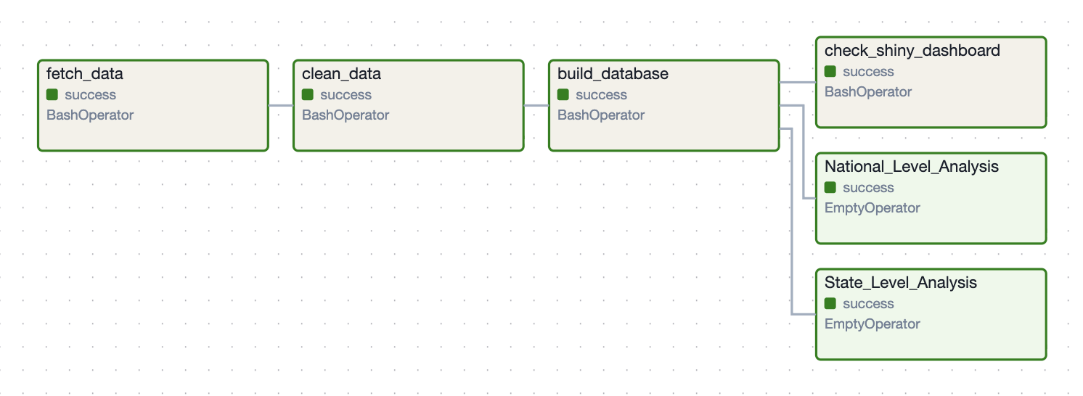

Slide 6
Data Issues & Fixes
Explore raw data

Slide 7
Analytical Findings

Slide 8
National Level Analysis

Slide 9
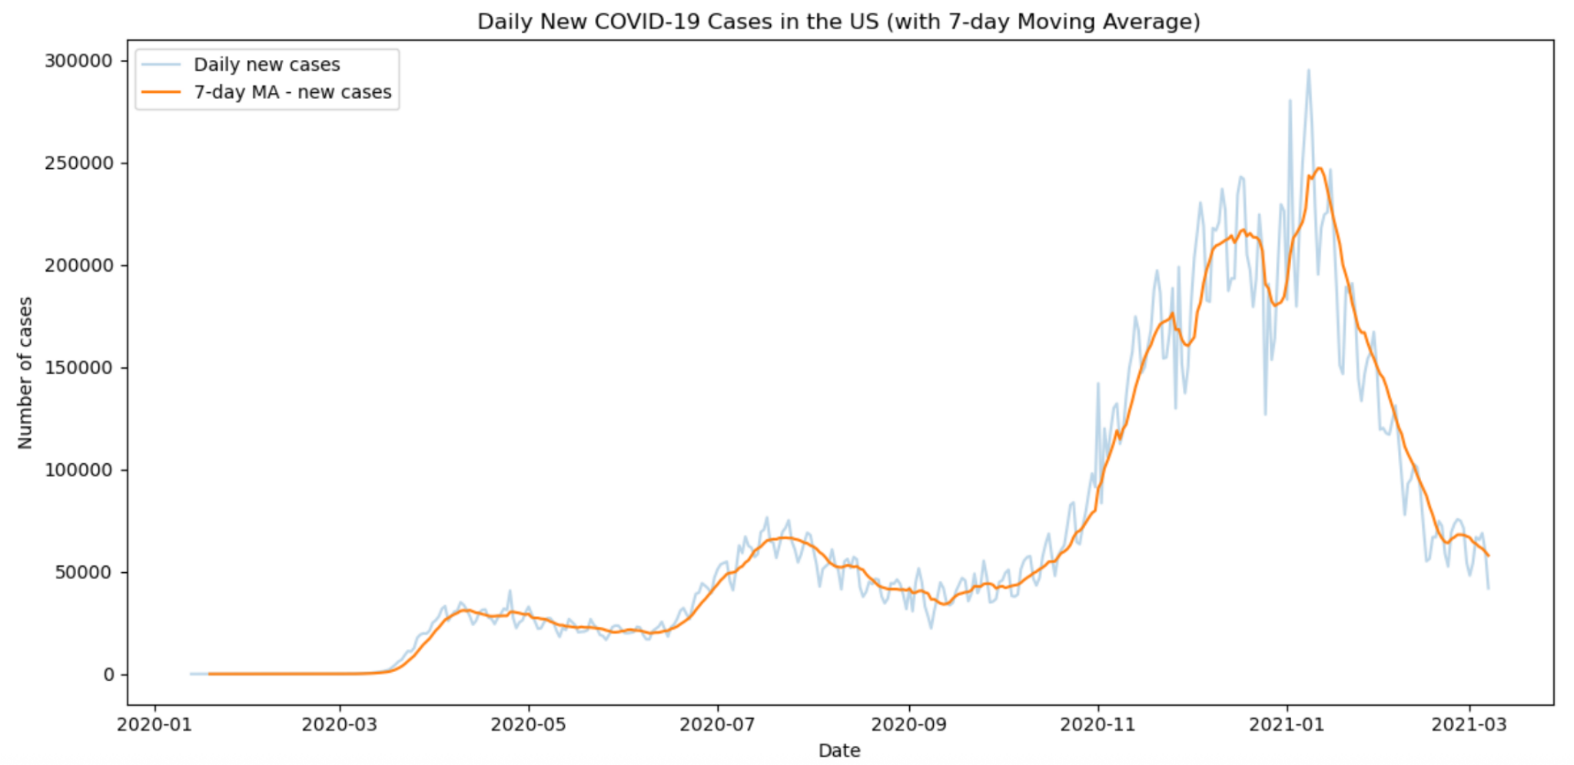
Early 2020: Cases stayed low before widespread transmission.
Apr 2020: First rise and peak, then a decline.
Jul 2020: Second wave with a higher peak than spring.
Fall 2020: Cases rose steadily after September.
Winter 2020–21: Largest surge, peaking in early January.
Early 2021: Strong decline after the January peak.

Slide 10
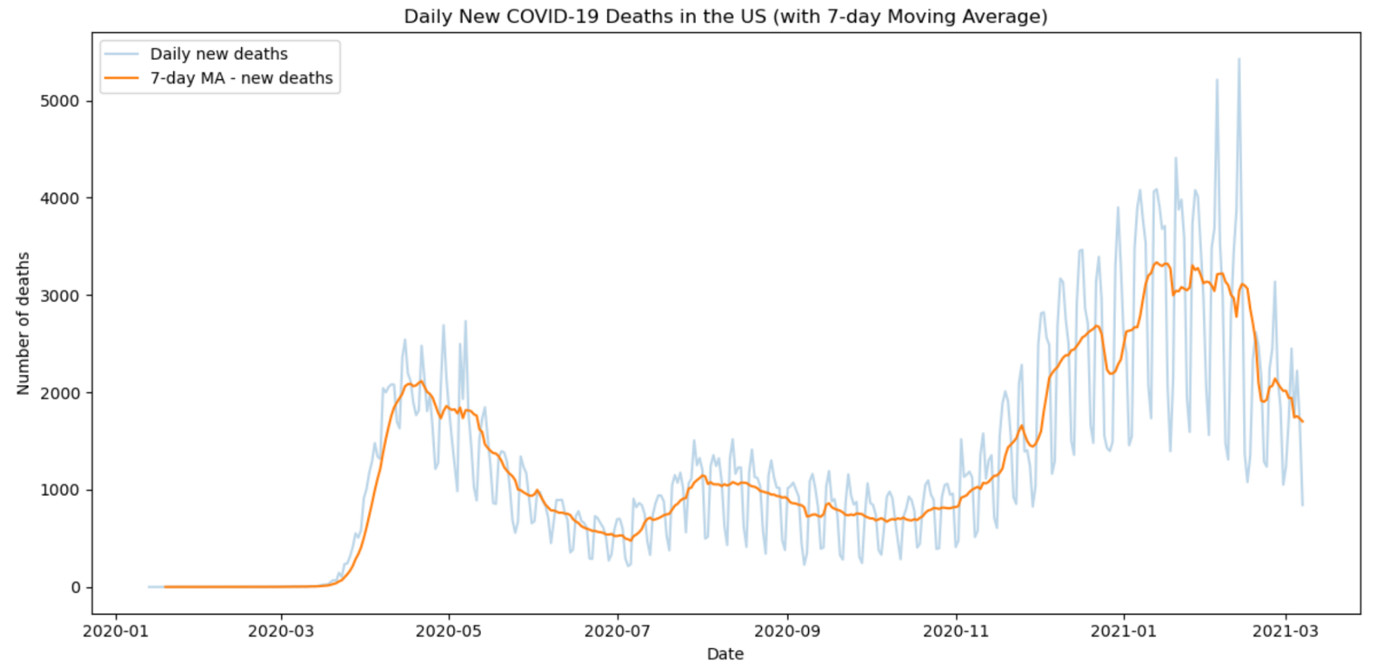
Deaths remained very low until March 2020.
First major peak in April 2020, then declined.
Summer 2020 shows a smaller secondary rise.
Deaths increased steadily again in late 2020.
Largest peak occurred around January 2021.
Clear decline after January 2021.

Slide 11
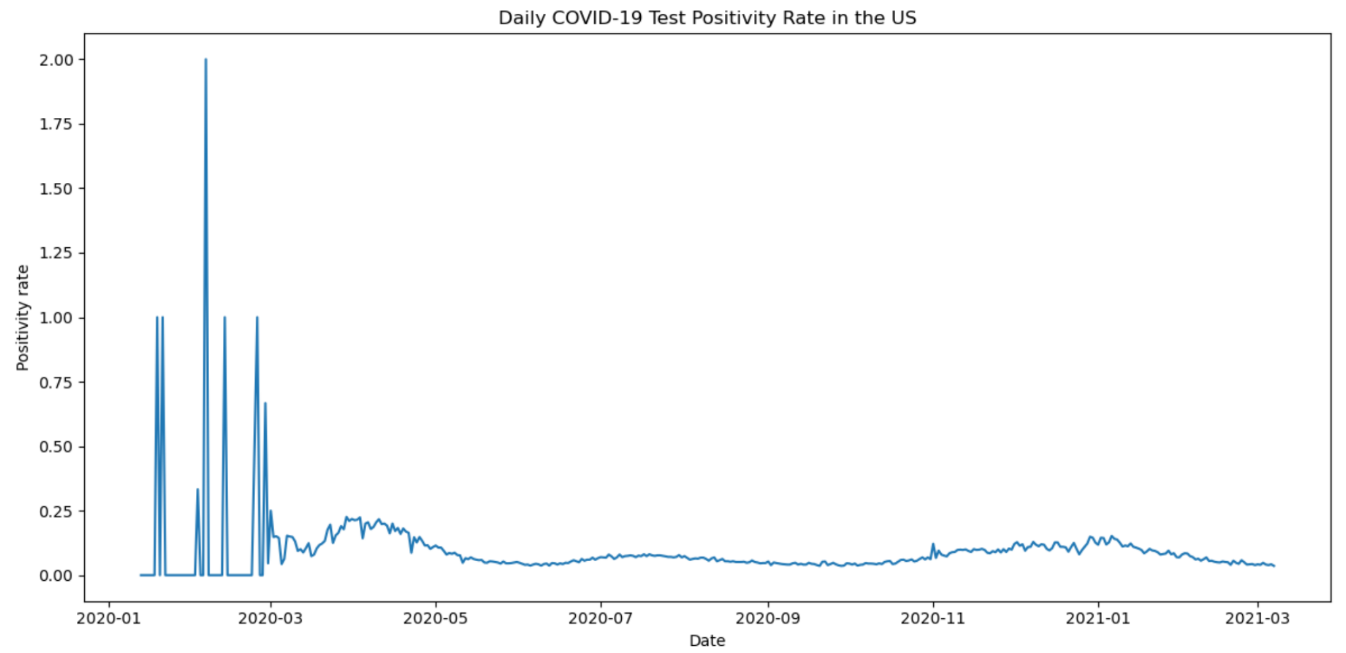
Early 2020 shows large spikes due to very low test volume.
After March 2020, positivity rate stabilizes at a lower and more reliable level.
A small rise appears around April, then declines through summer.
Late 2020 shows a gradual increase before falling again in early 2021.
Overall positivity rate remains relatively low compared to case/death trends.

Slide 12
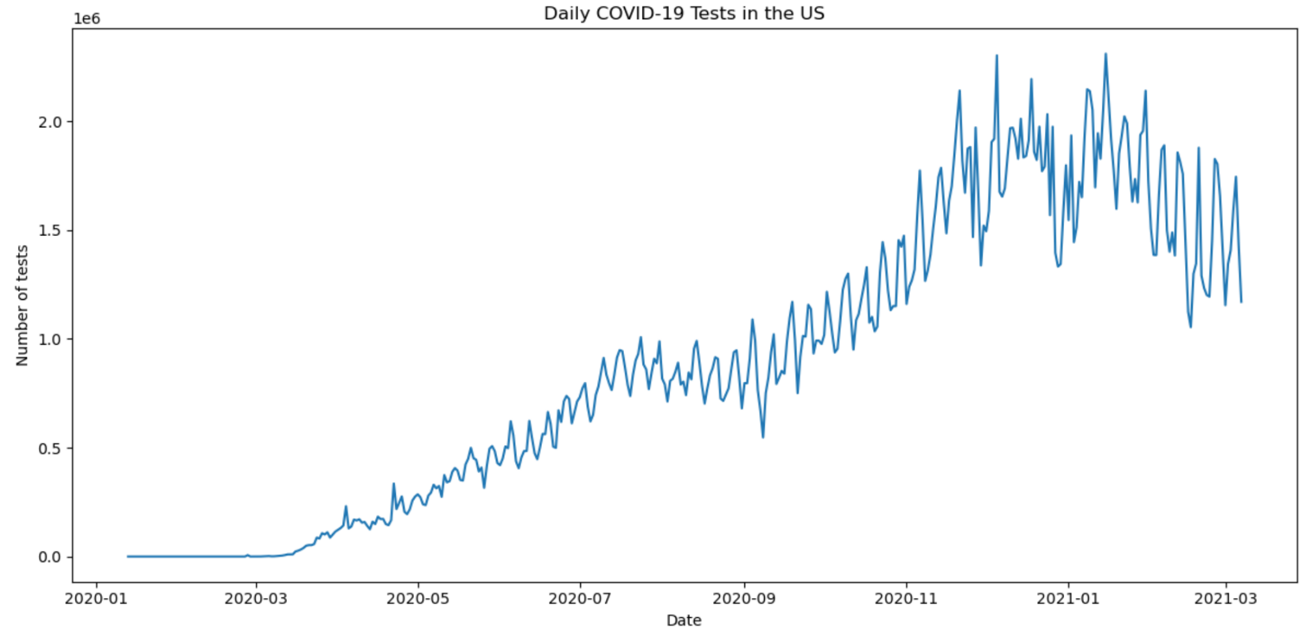
Testing was extremely limited before March 2020.
Rapid expansion of testing began in late March.
Testing volume increased continuously through summer 2020.
Significant growth in testing capacity occurred in fall and winter 2020.
Testing peaked around late 2020 to early 2021 (near ~1.5–2M tests/day).
Daily test counts show strong weekly cycles (weekend drop patterns).

Slide 13
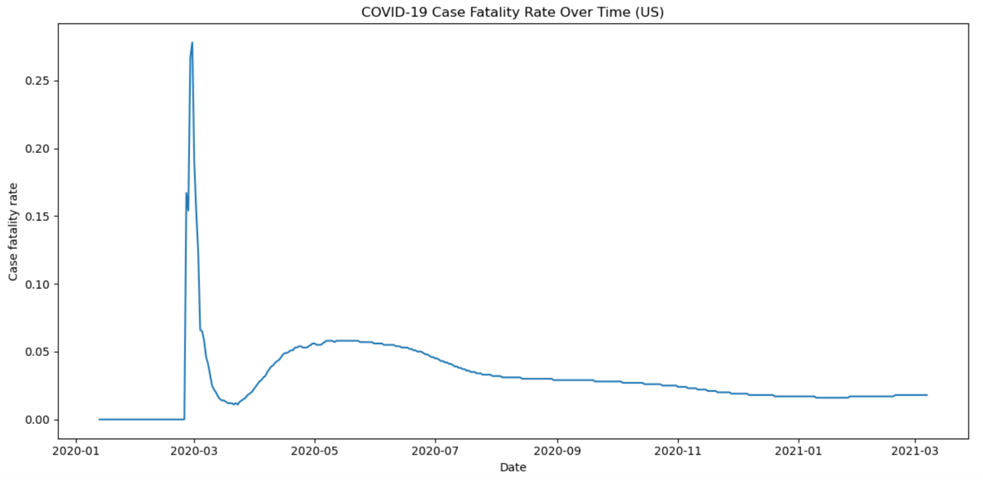
Very early data show extreme spikes due to low case counts and reporting delays.
CFR drops sharply after March as testing increases and data stabilizes.
CFR rises again in April–May 2020, reaching a mid-year peak.
Gradual decline continues through summer and fall 2020.
By late 2020 and early 2021, CFR stabilizes at a relatively low level.
Overall downward trend suggests improved treatment and expanded testing.

Slide 14
State Level Analysis

Slide 15
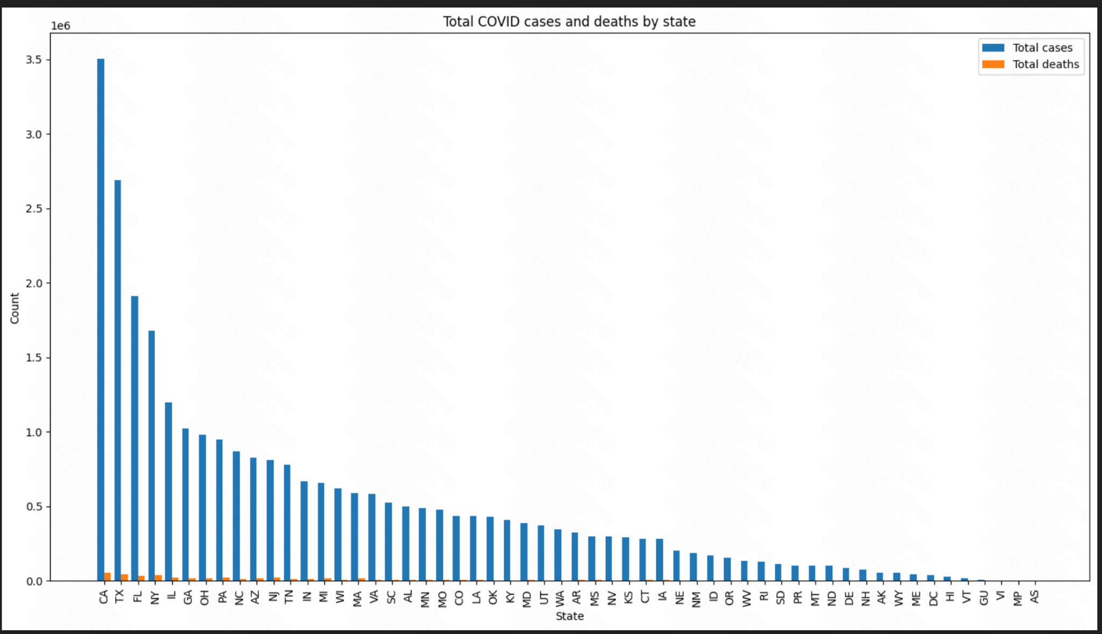
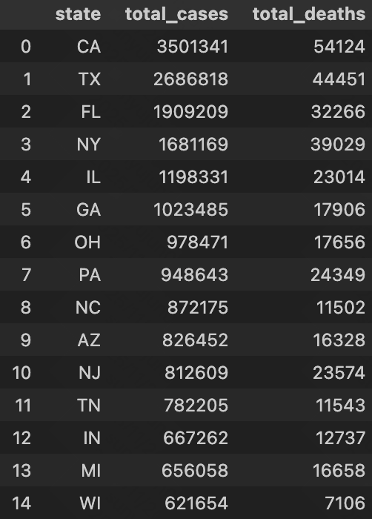
1.A few big states, like California (CA), Texas (TX), Florida (FL), and New York (NY), have the highest total COVID cases.
2. Many other states have much lower total case numbers, so the distribution is very uneven.
3.Total deaths are much smaller than total cases in every state.
4. States with many cases also usually have more deaths.

Slide 16
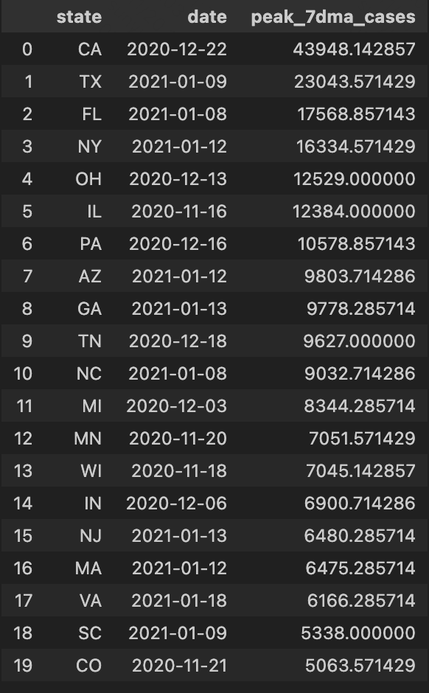
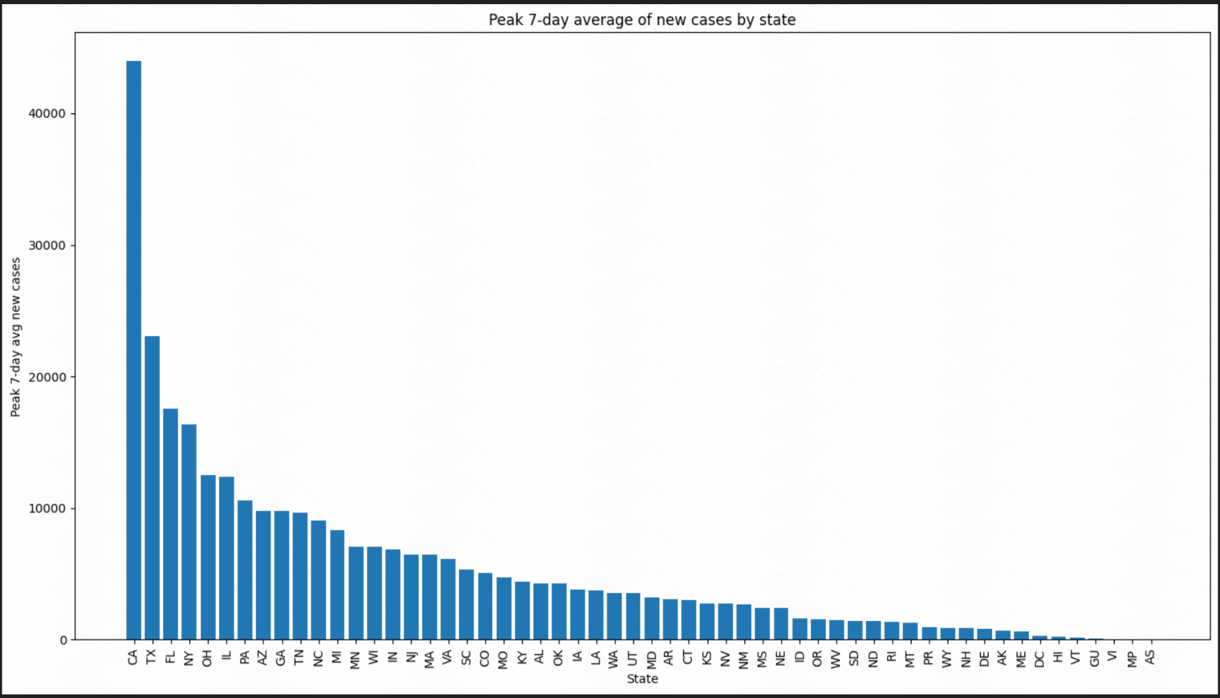
1. California (CA) has by far the highest peak.
Its 7-day average of new cases goes above 40,000, much higher than any other state.
2. Texas (TX), Florida (FL) and New York (NY) also have very high peaks.They form a second group below California but still much higher than most other states.
3.Many states have much smaller peaks. For a lot of states on the right side of the chart, the peak 7-day average is only a few thousand or even under 1,000 cases.
4. The distribution is very uneven.
A few large states have extremely high surge peaks, while most states have much lower peaks, so the bars drop off quickly from left to right.
5. This matches the total-cases pattern. States that had the largest total case counts (like CA, TX, FL, NY) also had the largest daily surges in new cases.

Slide 17
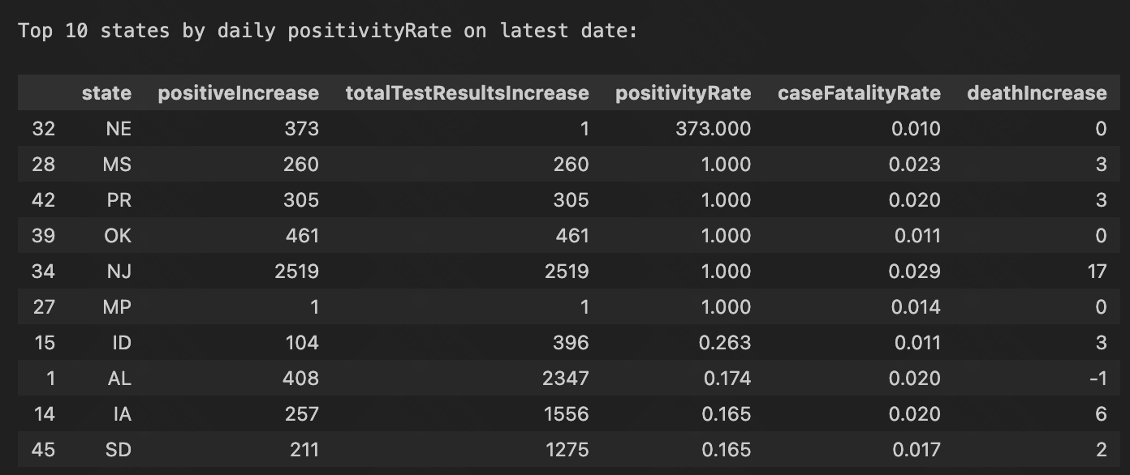
Data Latest Date: 2021-03-07

Slide 18
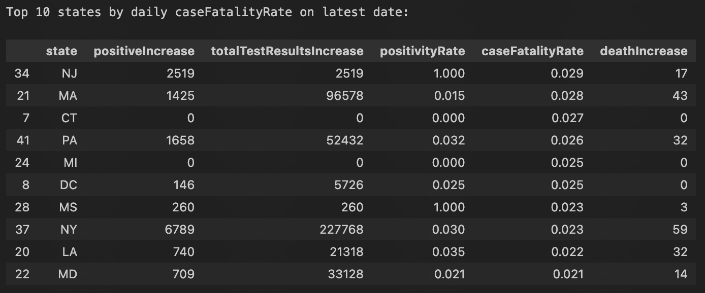
Data Latest Date: 2021-03-07

Slide 19
Github Repo & Dashboard Walkthrough
Link

Slide 20
Questions

Slide 21
Thank you
& wishing you a wonderful Thanksgiving!

